Slide 1
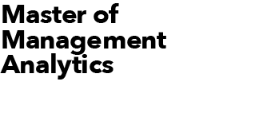
MMA Online Datathon 2018
Predicting Customer Churn at QWE Inc.
September 26, 2018 Prepared by Rahul Bhasin, Arka Basu and Arun Augustine (Team D)

Slide 2


Goals and Objectives
Business Objectives:
Identify the factors which influence the customer churn rate at QWE Inc. the most
Estimate how likely a given customer would leave in the next two months based on its historical behavioral data
Modeling Objectives:
Build a predictive model that can be used by QWE Inc. to predict the specific customers who are most likely to end their relationship (churn) with QWE Inc.
Suggest analytical solution and recommendations for proactive customer retention program

Slide 3
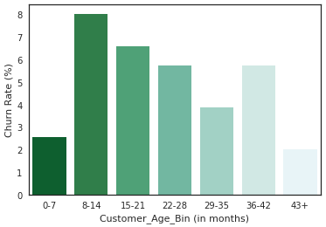
Important Predictors
Top Predictors driving customer churn
Based on the model built from Decision Tree, the top three factors influencing the customer churn at QWE Inc. have been identified as
Days since last login - Change
CHI – Current Month
Customer Age (i.e., tenure with QWE).
Thus, Mr. Well is correct with his suggestion that Customer Age and CHI Score are the two important predictors.
The Churn Rate within the age groups does not have any linear trend and it depicts a pattern of fluctuations. This does not align with Mr. Wall’s belief that the customers having tenure with QWE Inc. between 6 and 14 months are the riskiest group.
Furthermore, customers within 8-14 months group have the highest churn rate, indicating that the customers having 12-months contract left the QWE service after their contract expired.
Top 5 Important Predictors
Feature | Importance
Days Since Last Login - Change | 0.32
CHI - Current Month | 0.20
Customer Age (in months) | 0.16
CHI - Change | 0.13
Logins - Change | 0.09

Slide 4
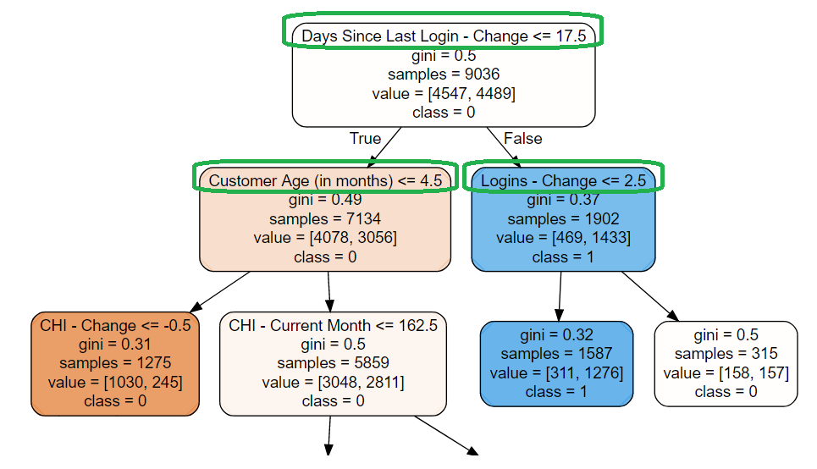

Making Smart Decisions Based on Decision Tree

Slide 5
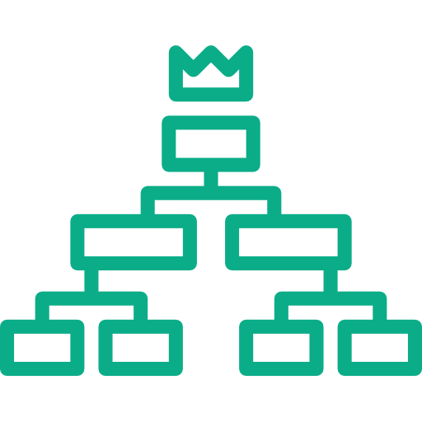
Subsetting Dataset
Carving out Risky Customers from dataset
The decision tree places the most important variables and splitting criteria within the top nodes. Based on top 3 nodes of the decision tree, the model reveals that the customer is likely to churn if it satisfies one of the following two conditions:
Thus, QWE Inc. must pay special attention to customers falling under these two criteria. A proactive customer retention program should be launched with the focus on these customers.
Subsetting these customers out of dataset reduces our original dataset significantly with the higher concentration of Risky Customers.
Days Since Last Login - Change > 17.5 and Logins - Change <= 2.5
Days Since Last Login - Change <= 17.5 and Customer Age (in months) > 4.5

Slide 6
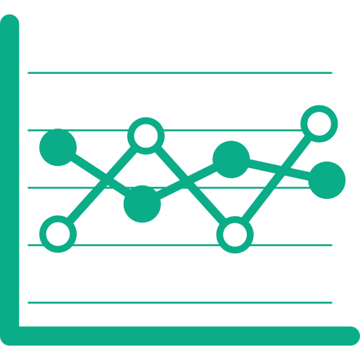
Predicting Churn Likelihood
Forecasting churn propensity for Risky Customers subset
Iterating several machine learning algorithms and fine-tuning parameters over Risky Customers subset shows that our model with XGBoost technique gives the best results with model Accuracy of 79.6% on test set. Our approach can be expected to identify 1.79 times higher* proportion of customers who would actually churn, when compared with no model approach having a random selection.
In this particular business problem, True Positive Rate is one of the most important model evaluation metrics because we are more concerned if our model wrongly predicts a customer to be non-churner when it will actually churn rather than predicting it churner when it will actually not. Therefore, True Positive Rate metric is the accuracy in this context. The True Positive Rate for our Churn Propensity model is equal to 75.9%.
Additionally, training the model on Risky Customers subset shows that the top 5 variables influencing the churn rate for Risky Customers based on feature importance are: Views – Change, CHI – Current Month, Customer Age, CHI – Change and Days Since Last Login – Change.
* Based on top decile. For more details refer Model Evaluation Metrics Summary slide in Appendix

Slide 7

Identifying subgroups within Risky Customers
 |  | Top 5 Predictors
Subsegment Identified | ID | Customer Age (in months) | CHI - Current Month | CHI - Change | Views - Change | Days Since Last Login - Change | Probability to churn | Actual Churn Value
1. Mysteriously Lapsed Contract Customers | 257 | 12 | 0 | 0 | 0 | 31 | 0.934 | 1
 | 1563 | 18 | 0 | 0 | -517 | 31 | 0.905 | 1
2. Highly Engaged Happy Customers | 978 | 12 | 161 | 53 | 1435 | 2 | 0.915 | 1
3. Lapsed Happy Customers | 918 | 13 | 102 | 7 | -7 | 31 | 0.882 | 1
 | 3144 | 12 | 34 | 33 | 0 | 31 | 0.895 | 1

Slide 8

Subgroups and Retention Strategies
Forecasting churn propensity for Risky Customers subset
Taking a closer look into the characteristics of few customers with the highest probability to churn as shown in the previous slide, we can classify the Risky Customers into three subgroups:
Mysteriously Lapsed Contract Customers: This subgroup of customers usually has customer tenure of 12, 18 or 24 months indicating that they discontinue QWE service once their contract ends. This subgroup never respond to our service satisfaction portion of the survey and have become lapsed. > Retention Strategy: Periodically contact them to measure their satisfaction level before their service contract expires and make sure they are satisfied with our service.
Highly Engaged Happy Customers: Customers belonging to this subgroup have used our service recently, have active logins last week and have high satisfaction in November. They might decide to end the contract because they do not need it anymore. This subgroup is the most important for QWE Inc. to retain among the three subgroups. > Retention Strategy: Call them to understand their service requirements.
Lapsed Happy Customers: This subgroup of customers have not logged in for a month but give positive feedback by showing satisfaction. These customers might not rely heavily on our service and are inactive. > Retention Strategy: Contact them to figure out the reasons for their inactivity and provide support.

Slide 9
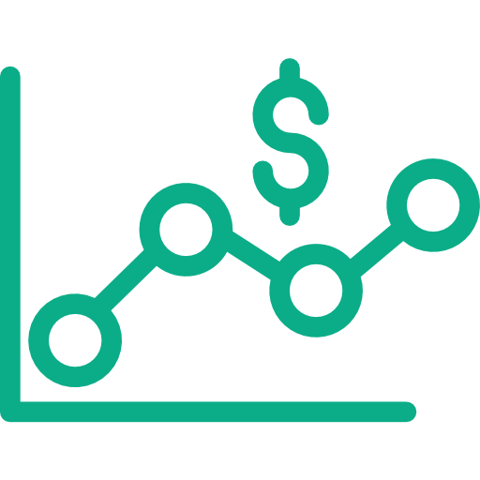
Financial Returns
Analyzing the need for a call-based retention program
Assumption: Let us suppose that the average customer conversion rate is 20%. That means out of 100 customers contacted by call-based retention program only 20 customers retain.
It is given that the Average ARPU (Average Revenue per User) for QWE is $100 per month and each phone call costs QWE $10.
We will target our Risky Customers subset using call-based retention program which contains 295 customers who would actually churn. Since True Positive Rate for our model is 75.9%, so out of 295 customers, 224 customers would be correctly targeted. Out of these 224 customers, 49 customers would actually retain because our assumed conversion rate is 20%.
Expected Financial Return per month = Total ARPU saved per month –
Total cost incurred in phone calls
= $4900 - $2950 = $1950
Hence, we would recommend QWE Inc. to launch call-based retention program and use our predictive model to support it based on our assumptions and calculations.

Slide 10
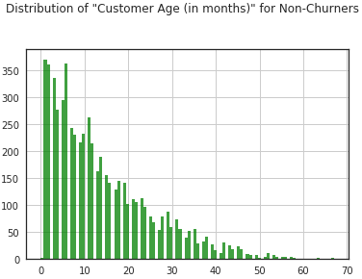
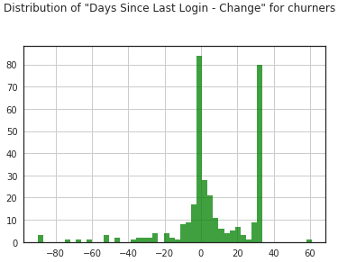
Segmentation Need
Natural customer segmentation for QWE Inc.
Our deep-dive analysis on dataset reveals that there are no such significant observable factors where customer churn behaviour is different, and thus customer segmentation won’t be much useful (for more details refer Correlation Heatmap and Distribution Plots for churn and non-churn customers in Appendix).
However, the two key insights observed in our dataset were:
The distribution of customer longevity for non-churners shows a higher number of new customers which linearly decreases with tenure. This was in contrast with the corresponding distribution for churners which doesn’t show a similar linear pattern and have peaks at 6, 12, 18 and 24 months, depicting expiration of their service contract.
For significant number of churn customers, 'Days Since Last Login - Change’ variable had value as 31 Days showing their inactive behaviour, which was missing in the plot for non-churn customers.

Slide 11

Appendix

Slide 12
Model Evaluation Metrics Summary
For further details and Decile Analysis refer attached file below :-
Machine Learning Technique Used : XGBoost (since dataset was unbalanced, oversampling was done)
Sensitivity (True Positive Rate) = 75.9% | Specificity = 83.3% | Accuracy = 79.6% | Cut-off Used = 0.50
Lift chart and gain chart:

Slide 13
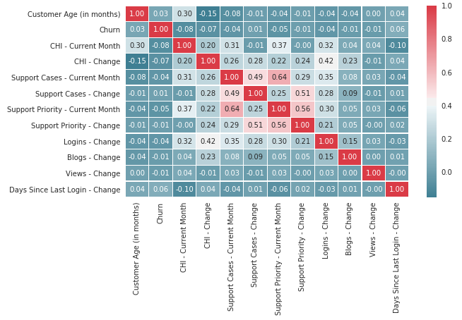
Variables Correlation Heatmap
The Variables Correlation Heatmap depicts that there is no significant correlation among variables (specially with ‘Churn’ variable).

Slide 14
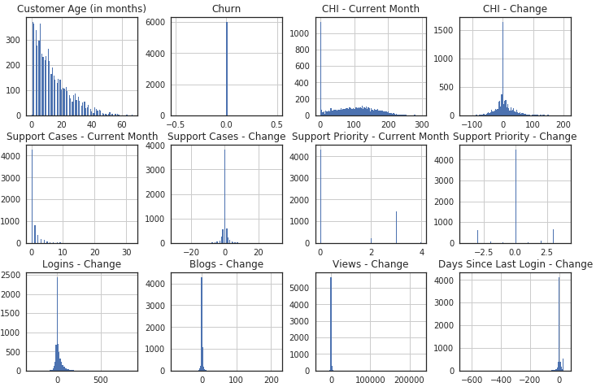
Variables Distribution Plots (Non-Churn Customers)
Distribution plots reveal that there are no such significant observable factors where customer churn behaviour is different (except for Customer Age and Days Since Last Login – Change variables), and thus customer segmentation won’t be much useful.

Slide 15
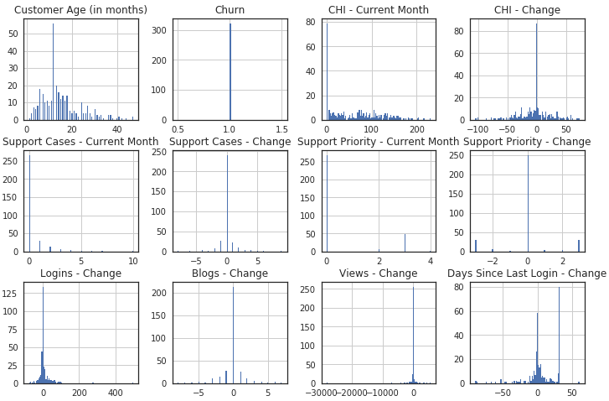
Variables Distribution Plots (Churn Customers)
Distribution plots reveal that there are no such significant observable factors where customer churn behaviour is different (except for Customer Age and Days Since Last Login – Change variables), and thus customer segmentation won’t be much useful.

